Slide 1
Hotel hospitality
Data Analysis Project

Slide 2
Tools used:-
Microsoft Power BI
Power Query
DAX
Microsoft Excel Power Pivot
Power BI Service (app.powerbi.com)

Slide 3
Problem Statement
The Project belongs to Hospitality Domain and deals with the challenges faced by AtliQ Hotel Chains which is a Dominant player in Hotel Hospitality Business Domain.
The Management and Stakeholders needs to take leverage of Data so that they can execute calculated Data Driven Decisions.

Slide 4
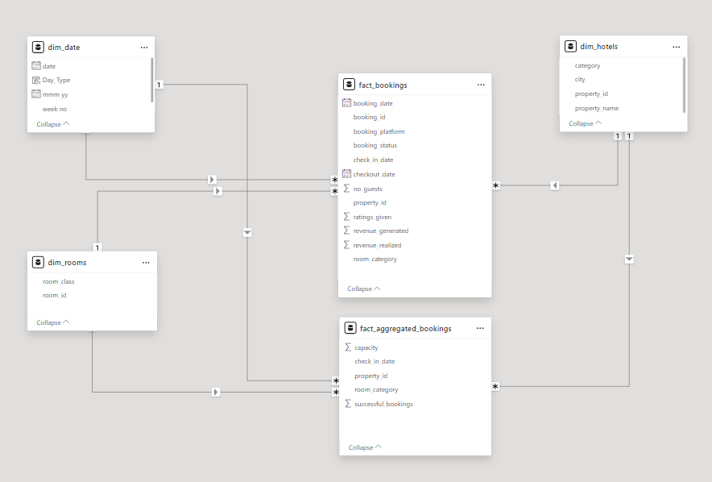
Data Modelling
FACT Tables

Slide 5
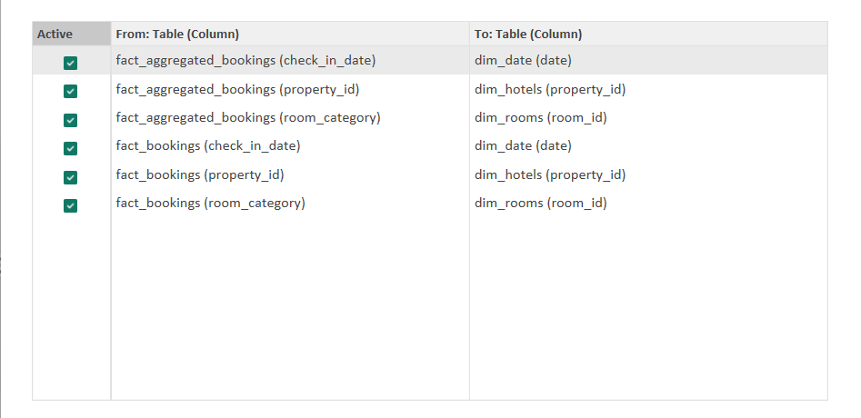
Relationships
Foreign Keys of FACT Tables
Primary Keys of Dimension Tables

Slide 6
Key KPIs :-
Revenue Sum(Revenue Realized)
RevPar (Revenue Per Avg. Room) Revenue Realized/Total Capacity
Occupancy % Total Successful bookings/Total Capacity
ADR (Average Daily Rate) Revenue Realized/Total bookings
Realisation % 1 – (Cancellation% + No Show%)
Cancellation % Total Cancelled Bookings/Total Bookings
No Show % Total No show bookings/ Total Bookings
DBRN (Daily Bookings Room Nights) Total Bookings/ No. of Days
DSRN (Daily Sellable Room Nights) Total Capacity/ No. of Days
DURN (Daily Utilized Room Nights) Total Checked Out/ No. of Days
Average Rating AVG(Ratings Given)

Slide 7
Lets Go to our Dashboard

